Slide 1
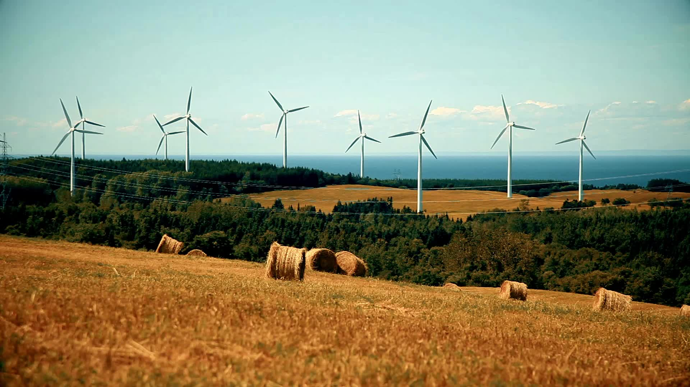
Sources Of Energy
Presented by-
Group 16
46. Omkar Vitthal Savant
47. Diksha Pravin Sawant
48. Om Vilas Shimpi

Slide 2

Energy
Energy is the capacity of a physical system to perform work
It exist in several forms such as heat, kinetic or mechanical energy, light, potential energy, electrical, or other forms.

Slide 3

Types
Non-Renewable Energy
Renewable Energy

Slide 4
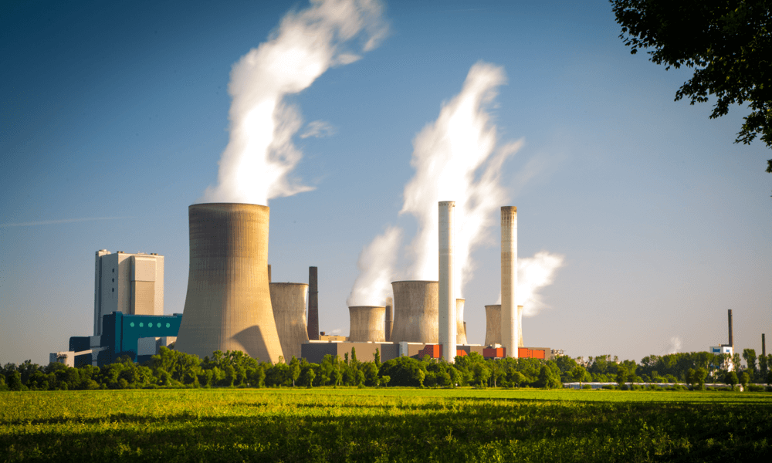
Non-Renewable Energy
Non-Renewable is a energy which can be created or renewed again.
These are traditional sources of energy like coal and petroleum.
Non renewebale energy sources are finite.
They will not last forever.

Slide 5
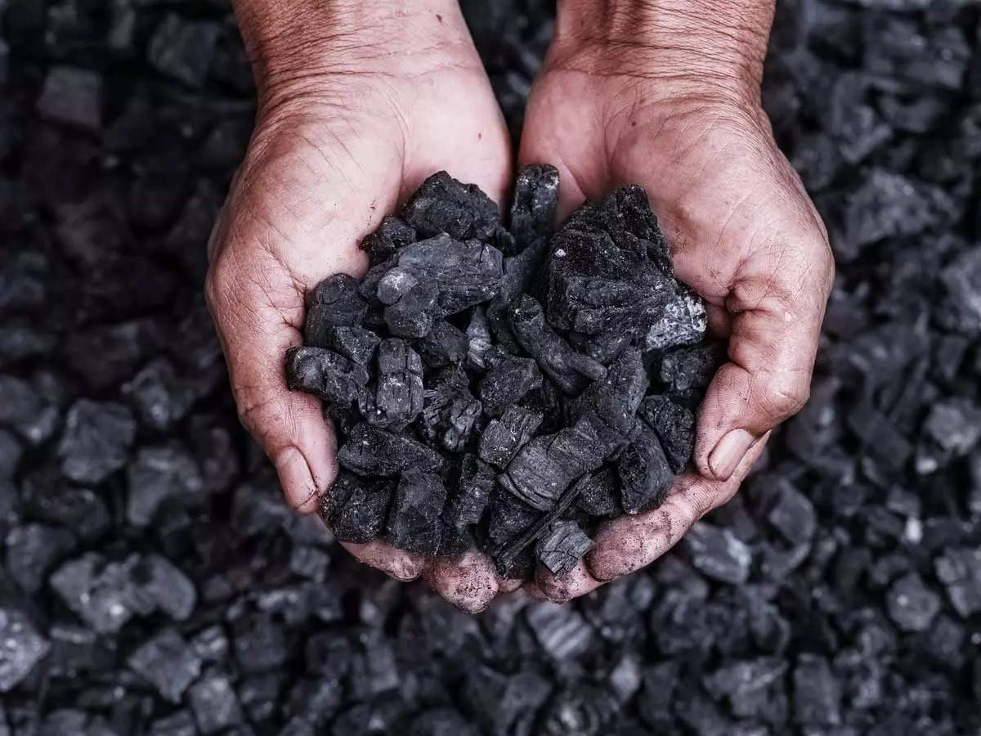
Coal
Coal releases large amount of energy when it is burned because of the density of hydrocarbons in the material.
Coal is formed by dead plants being put under significant pressure and temperature for millions of years.
There are four grades of coal: Lignite, subbituminous, bituminous coal and anthracite.

Slide 6
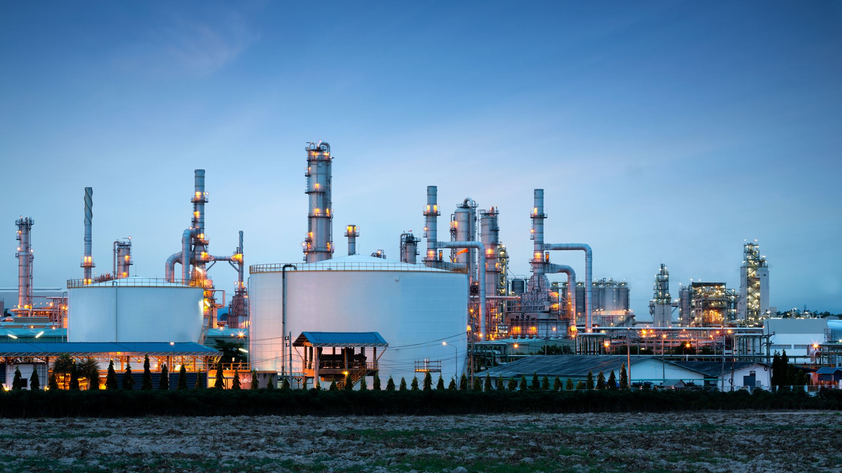
Petroleum
Petroleum is formed from the compression of animal and plants remain over millions of years.
Petroleum has to be drilled because it is located deep below earth surface.
Then it is redefined to use for different products including gasoline, diesel

Slide 7

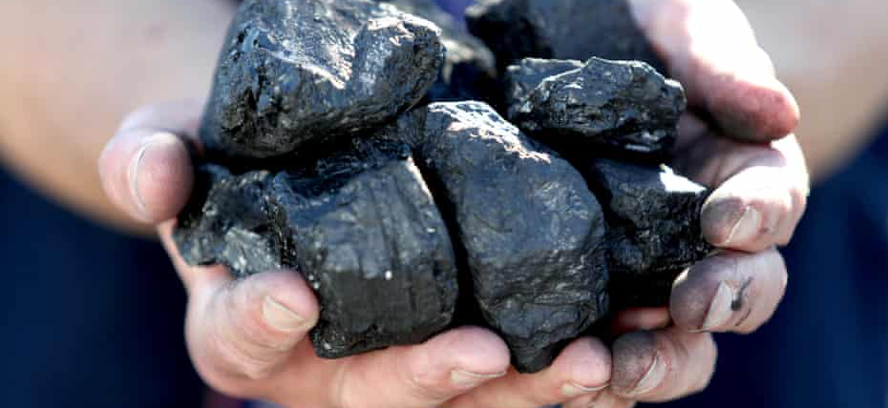
Advantages of Non-Renewable Energy
The main advantages of non-renewable energies is that they are abundant and affordable.
Non-renewable energy is cost effective and easier to product and use.
Non-renewable resources are high in energy.
Most of the non-renewable sources are also very easy to store

Slide 8
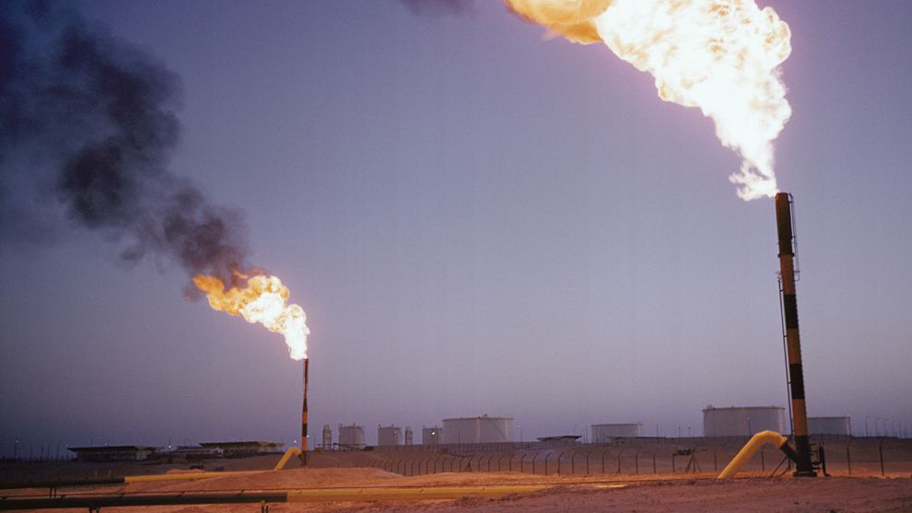
Disadvantages of Non-Renewable Energy
It produces greenhouse gases.
Its by products cause damage to the environment.
Once exhausted they are not easily replenished
Its residual products are generally non-biodegradable

Slide 9

Renewable Energy
Renewable energy is natural energy which does not have a limited supply. They can be used again and again and will never run out.
It is energy which comes from natural resources such as sunlight, wind, rain which are renewable.
It is alternative to fossil fuel and was commonly called alternative energy.

Slide 10
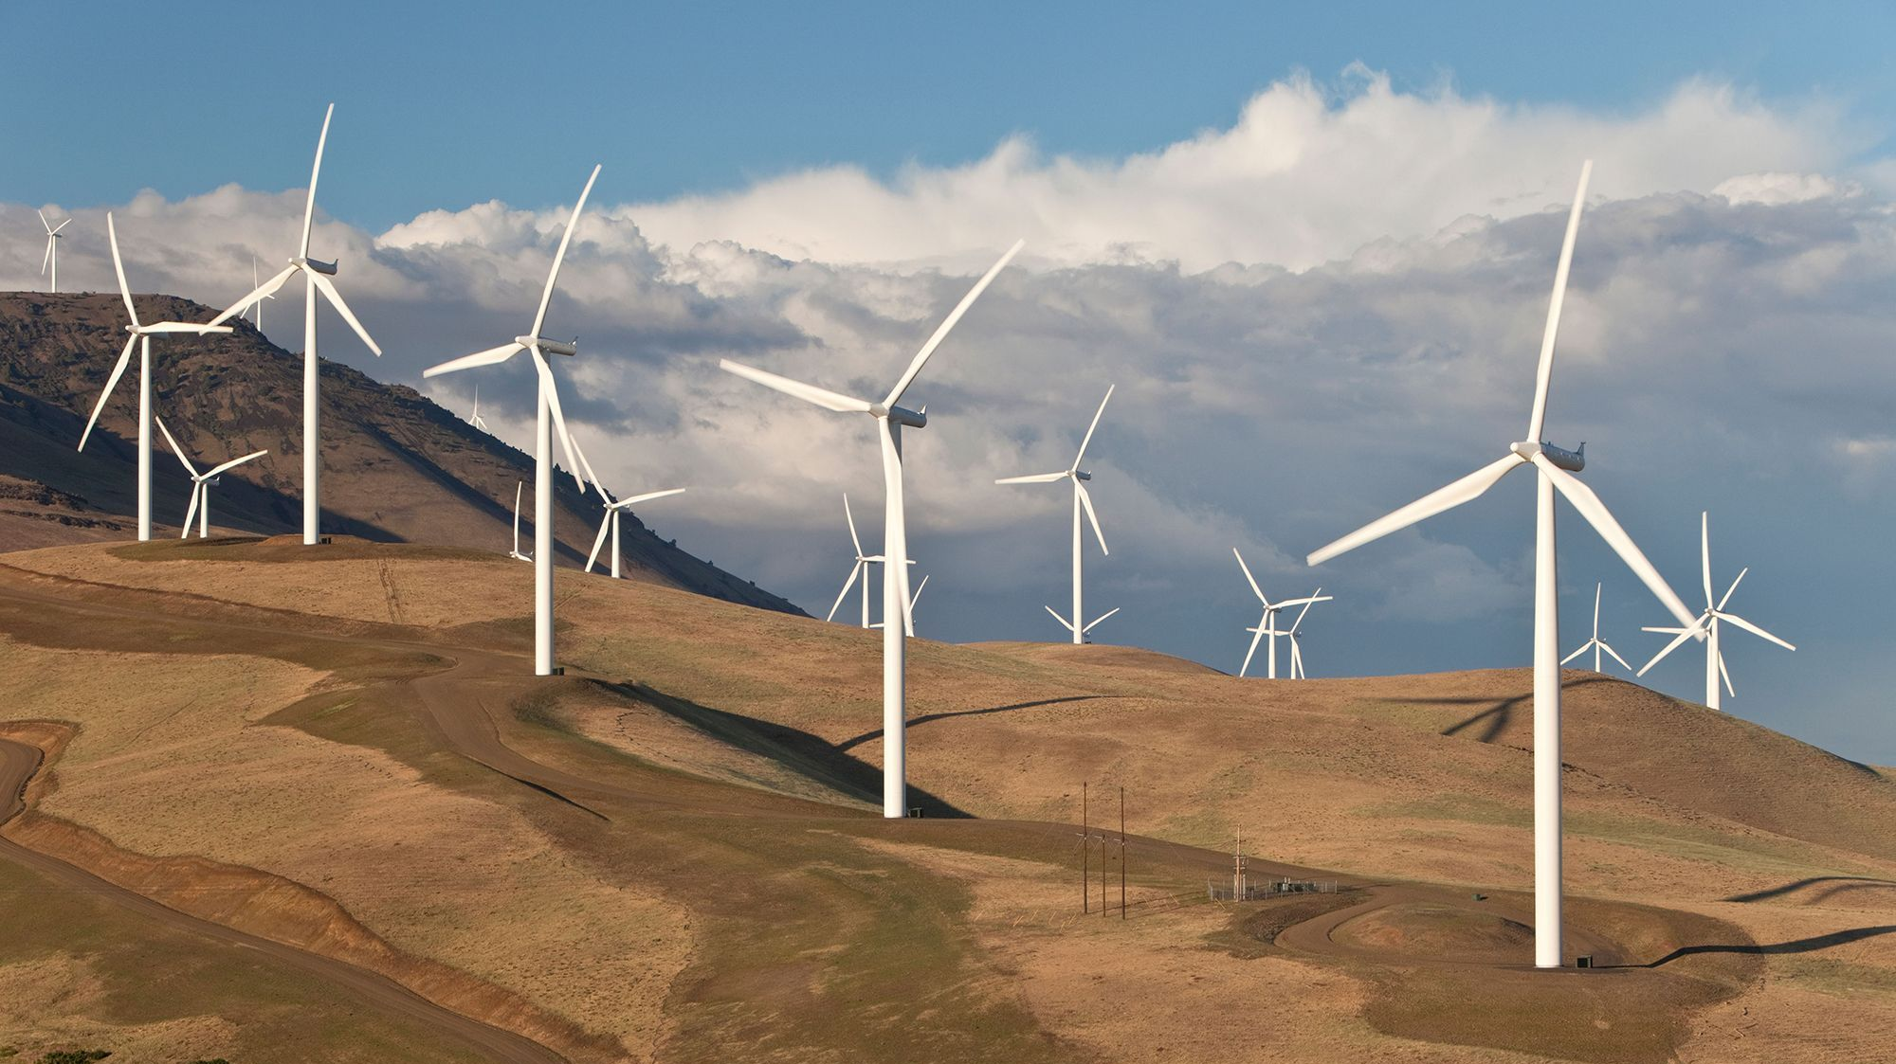
Wind Energy
Air flows can be used to run wind turbines.
Areas where winds are stronger and more constant such as offshore and high altitudes sites are preferred location for wind farms.
As wind speed increases, power output increases significantly.

Slide 11

Solar Power
Solar energy is the energy derived from the sun though form of solar radiation.
Solar powered electrical generation relies on photovoltaic and heat engines.
A partial list of other solar applications include solar cooker and solar water heater.

Slide 12
Advantages of Renewable Energy
They are renewable and cannot be depelected.
They are clean energy, they don’t cause pollution.
Less Maintenance
Can be replenished in short period of time

Slide 13

Disadvantages of Renewable Energy
They're very expensive.
It is difficult to produce large amount of energy
Takes a Lot of Space to Install
Expensive Storage Costs

Slide 14
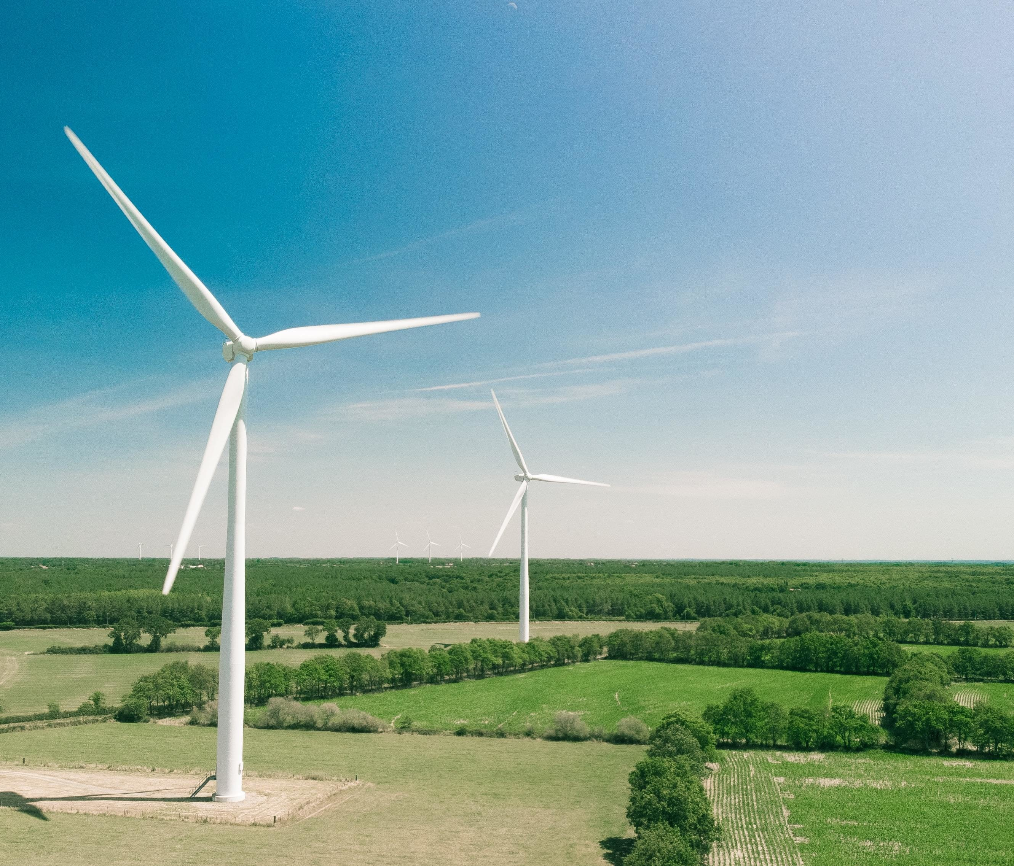

Conclusion
Energy plays a crucial role in modern societies.
It has a vital input to all sectors (e.g. residential, transportation, and manufacture) and is essential to generate electricity.
In other words, all societies require energy services to meet basic human needs such as lighting, heating, and mobility.
Thus, energy is not just a regular commodity, rather it is a strategic one and is the lifeblood of today’s civilization.

Slide 15
Thank You!

